Slide 1
Heart Failure Trends
BY:
Alex Maciel
Raphael Sheikh
Vidya Velusamy
Ikenna Nwachukwu
Daniel Abrego

Slide 2
Introduction
Heart failure is a significant health concern globally, characterized by the heart's inability to pump sufficient blood to meet the body's needs. This condition can lead to severe consequences, including diminished quality of life and increased mortality rates. Various factors contribute to the risk of developing heart failure, with family history being a notable determinant. Understanding the role of family history in heart failure can provide insights into its hereditary aspects and help in early identification and management of at-risk individuals.

Slide 3

Project Description
The purpose of this project is to identify heart failure trends within a given population.
Utilizing death rates, age, race, gender, and other medical conditions. The team will look to predict futuristic trends.

Slide 4
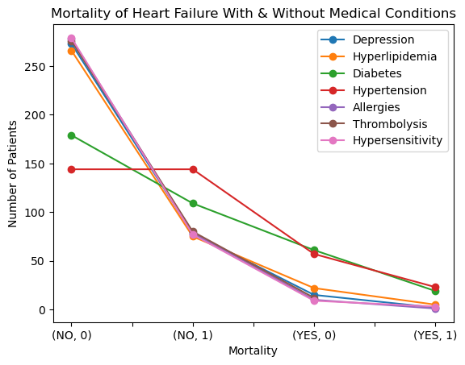
Mortality of Certain Medical Conditions with Heart Failure
Here we can see the common medical conditions within Heart Failure with Mortality.
A main points of interest are the “YES, 0” and “YES, 1”. Showing that people that have medical conditions don’t show correlation to mortality.
While people that do not have medical conditions; show that they unfortunately passed.

Slide 5
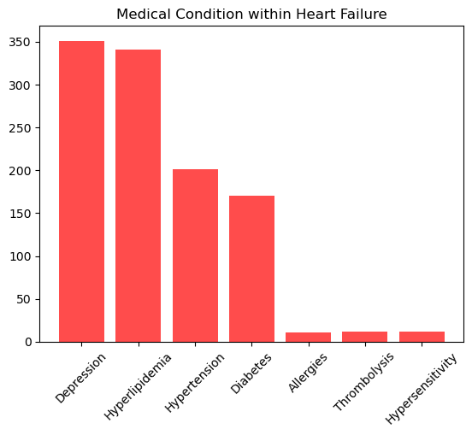
Common Medical Conditions within Heart Failure
We can see here the most and least common medical conditions within Heart Failure.
Top medical conditions being Depression and Hyperlipidemia.
Luckily, anyone having allergy symptoms can take a sigh of relief.

Slide 6
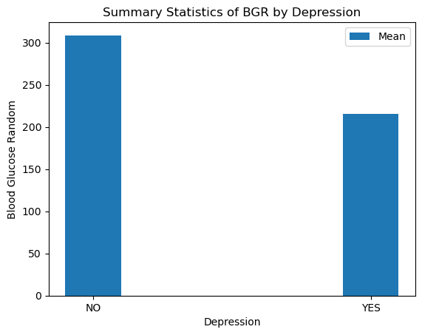
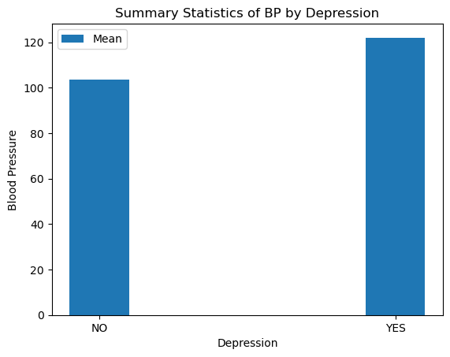
Heart Failure Vs Depression
Normal BP levels:
Systolic BP: Less than 120 mm Hg
Diastolic BP: Less than 80 mm Hg
Fasting Blood Sugar (FBS):
Normal range: 70-100 mg/dL (3.9-5.6 mmol/L)
Postprandial Blood Sugar (PPBS):
Normal range: Less than 140 mg/dL (7.8 mmol/L) two hours after eating
Random Blood Sugar (RBS):
Normal range: Less than 125 mg/dL (7.0 mmol/L) in non-diabetic individuals

Slide 7
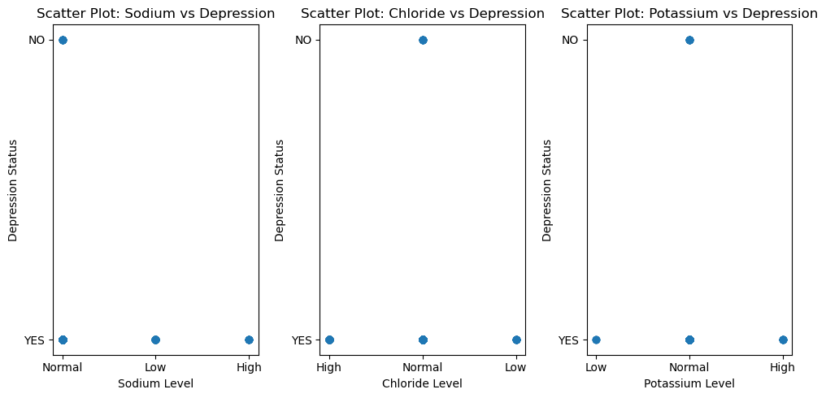
Heart Failure Vs Depression
Electrolyte Levels
Normal reference range for sodium (mEq/L) - 135 -145
Normal reference range for potassium (mEq/L) – 3.5 – 5.0
Normal reference range for chloride (mEq/L) – 98 - 106

Slide 8
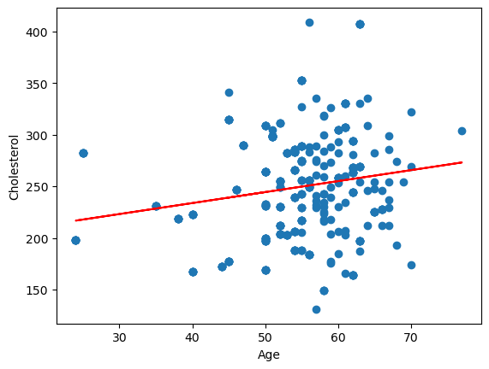
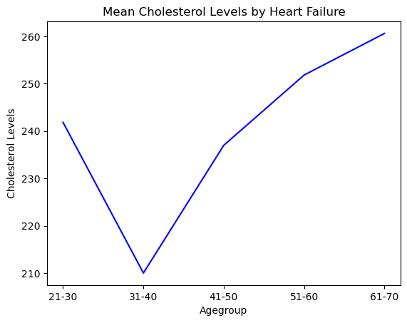
Heart Failure Vs Hyperlipidemia
r- value = 0.18
Total Cholesterol:
Desirable: Less than 200 mg/dL (5.2 mmol/L)
Borderline high: 200-239 mg/dL (5.2-6.2 mmol/L)
High: 240 mg/dL (6.2 mmol/L) or higher

Slide 9
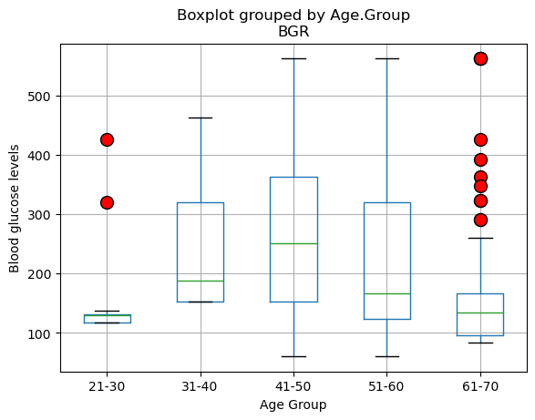
Blood Glucose Level

Slide 10
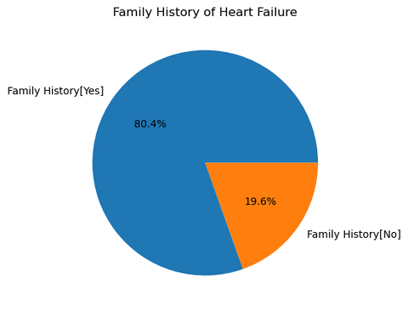
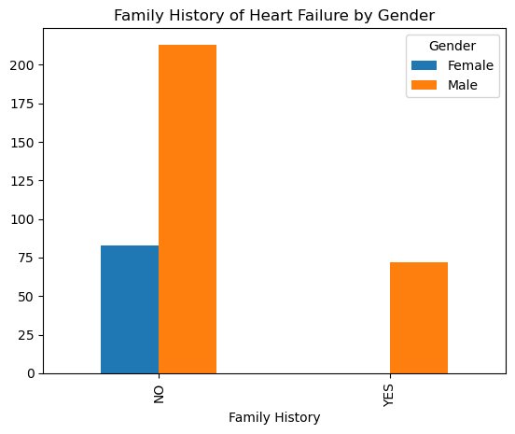
Family History Vs Heart Failure
The pie chart shows the distribution of family history related to heart failure. The majority, 80.4%, of the respondents have a family history of heart failure, while 19.6% do not have a family history of heart failure.
The bar chart portrays the family history of heart failure categorized by gender. The chart reveals the following:
- Among those with no family history of heart failure, approximately 75 are female, and over 200 are male.
- Among those with a family history of heart failure, there are no females represented, while about 75 are male.
This suggests that all individuals with a family history of heart failure in this dataset are male.

Slide 11
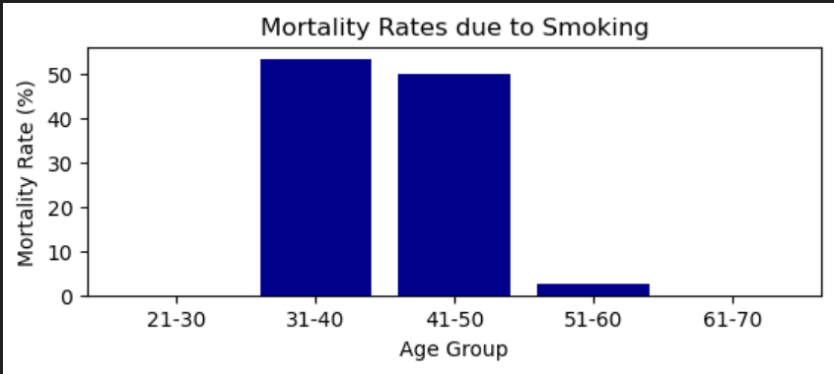
Age Group Analysis
Highest Mortality Rate due to Smoking:
The age group with the highest mortality rate due to smoking is 60-70 years with 30.1%.
Age Group | Mortality Rate (%)
30-40 | 12.5
40-50 | 18.2
50-60 | 25.8
60-70 | 30.1
70-80 | 28.6

Slide 12
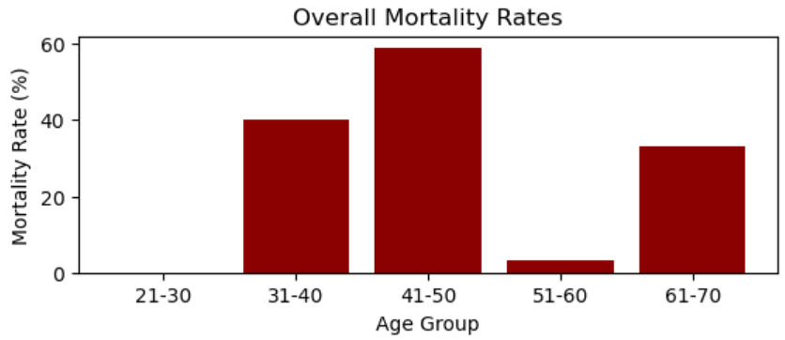
Overall Age Group Analysis
Highest Mortality Rate:
The age group with the highest mortality rate is 60-70 years with 32.4%.
Age Group | Mortality Rate(%)
30-40 | 15.2
40-50 | 20.5
50-60 | 27.9
60-70 | 32.4
70-80 | 29.8

Slide 13
Mortality Rates
Gender by Region
Age group by Region
Urban males have a higher mortality rate while rural females have a higher rate
Urban age group 41-50 have the highest rate
Rural age group 61-70 have the highest rate

Slide 14
Mortality YoY Trends
US Year over Year
US vs Other Countries
Cardiovascular related death has been trending up over the years in the US
US continues to be a leader amongst the other countries for cardiovascular related deaths

Slide 15

Thank You

